Slide 1
Card Acquisition from non-card holder base
JULY 2017
PLATFORM ANALYTICS

Slide 2
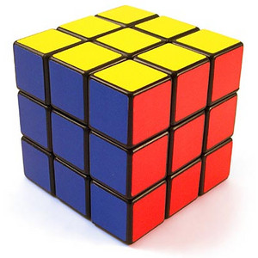
Analysis Approach 1:
Algorithm
We create various segment for detail understanding of card holder base
Few of the dimension for understanding :
Recency
Frequency
Monetary
Browse Pattern
# Brands Customer shops in
Engagement channels (example- Online, Retail, app user etc)
We will measure % card user at each of the sub-segment
Define a metric :
Card User base potential = (% Baseline of card user) / (% card user in stratified cluster)
% Baseline can be overall % of card user
Higher the metric value means less penetrated the segment is
We can rank order basis “Card User base potential “ on descending order and access the less penetrated segments in a scientific and efficient manner
Monetary
Recency
Frequency
This Algorithm intention is to increase overall penetration

Slide 3
Analysis Approach 2:
Algorithm Modified from 1
We create various segment for detail understanding of card holder base
Few of the dimension for understanding :
Recency
Frequency
Monetary
Browse Pattern
# Brands Customer shops in
Engagement channels (example- Online, Retail, app user etc)
We will segment the loyalty card holders in three groups
High Profitable
Break-even
Free Riders (Less required)
At each stratified segments we will get the % of High Profitable among loyalty holders.
Segments with % high profitable grouped can be rank ordered in descending fashion to target most profitable group
Monetary
Recency
Frequency
This Algorithm intention is to increase penetration on profitable customers

Slide 4
Analysis Approach 3:
Algorithm Based on Prediction
We use the LTV model to identify the best customer base and target them for card program if they are not holding
We may augment the above point overlaying the time to next purchase score/ attrition score
Algorithm Based on Net Promoter Score
We can do a transaction and frequency study of all the customers who has exhibited likelihood recommended brand to others. We may target similar profile customers

